Slide 1
More HTML
Mr Mack 2021

Slide 2
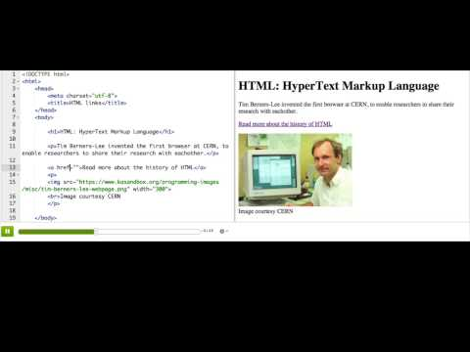
HTML links

Slide 3

Practice: Links for learning
This webpage contains a list with three empty items. Add a link in each item that points to an educational website
Add links

Slide 4

Practice: Links for learning
Now, below the list, turn the heart image into a link to your favorite educational website. Remember to put the opening <a> tag before the <img> tag and put the closing </a> tag after it.
Link love

Slide 5
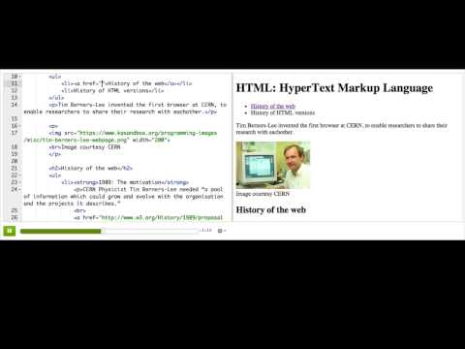
HTML internal Links

Slide 6
Practice: Jump around
This is a long webpage describing kangaroos, and each section heading has an id attribute. Find out what those id attributes are, and then change the href attributes of the links at the top to point at the appropriate section.
Add internal links

Slide 7
Practice: Jump around
There's one more link at the bottom that should link back to the top. Fix its href so that it does that.
Add one more

Slide 8
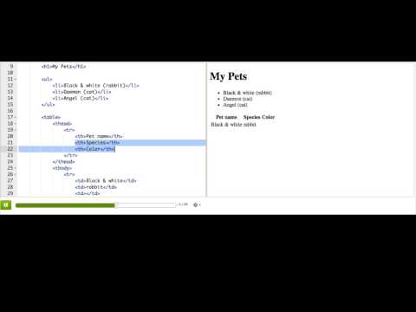
HTML tables

Slide 9
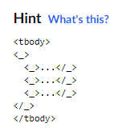
Practice: The dinner table
This is a webpage to show the dinner menu for a restaurant. We've created the initial table with three columns for the meal, ingredients, and price. Now, add three rows of data to the table, one row for each meal.
Add rows of meals

Slide 10
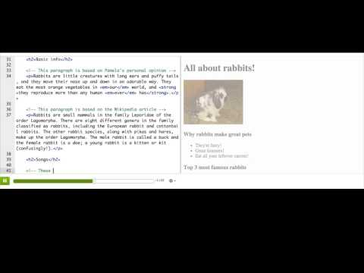
HTML comments

Slide 11
Challenge: Recipe book
Create a web page with your favorite recipes! The recipe book should have a table of contents linking to each recipe below, using internal links. Each recipe should have a table for the ingredients, a list of details, and a list and/or paragraphs of the steps required. If you use recipes from the internet, be sure to add a link to the website.
Use CSS to style the recipe book, using a mix of the simple selectors and colors that you've learned.
Tip: Can't find the images you want in our image selector? You can also bring in images from Wikipedia. To do that, use a site-restricted Google search, then click "View image" on the result you like, and copy the URL into your <img> tag.

